Slide 1
A Data science Project on
Used Car Price Prediction
Submitted by: Santosh Arvind Dharam

Slide 2
Problem Statement
With the Covid-19 impact in the market, we seen lot of changes in the car market. Now some cars are in demand hence making them costly and some are not in demand hence cheaper. One of clients works with small traders, who sell used cars. With the change in market due to Covid-19 impact, client is facing problems with their previous car price valuation machine learning models. So, they are looking for new machine learning models from new data. We have to make car price valuation model.

Slide 3
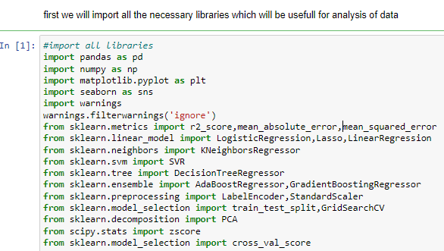
EDA steps step-1(import necessary libraries)

Slide 4
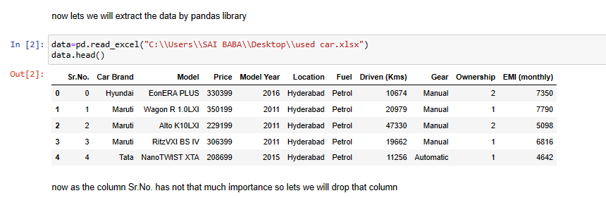
Step-2(extract the dataset in jupyter notebook)

Slide 5
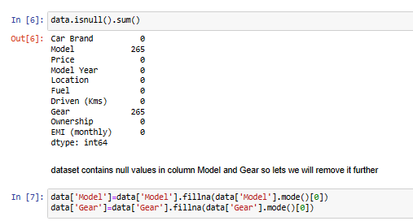
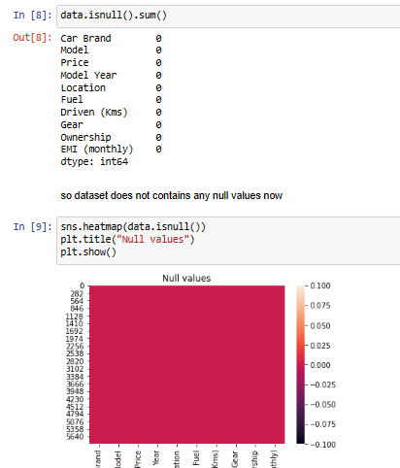
Step-3(checking and removing null values)

Slide 6
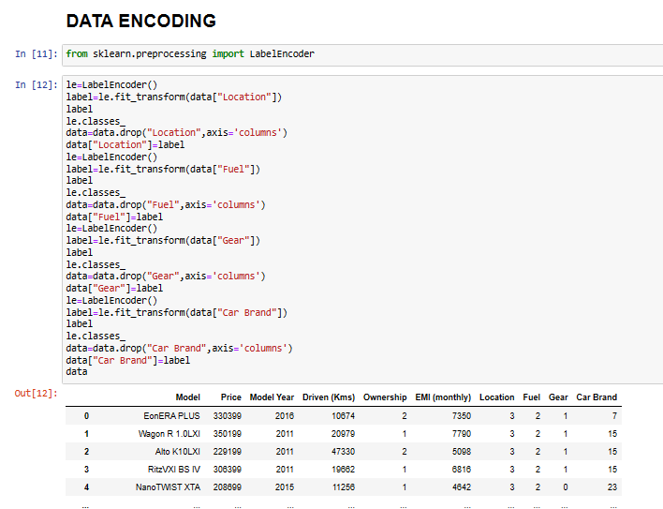
Step-4(Data Encoding)

Slide 7
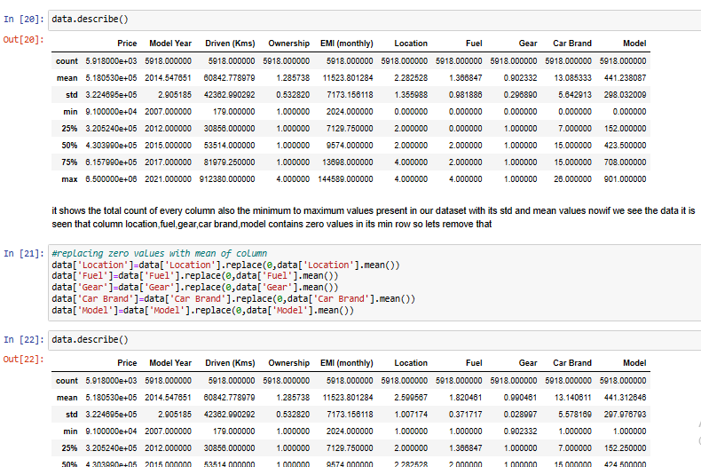
Step-5(Data Description and removing zero values present in min rows)

Slide 8
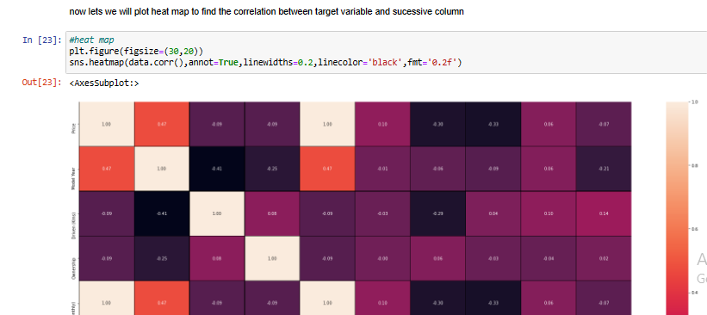
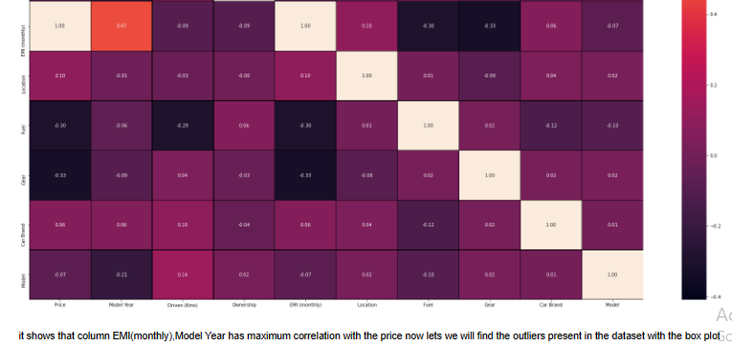
Heat Map(corelation between target column and sucessive column)

Slide 9
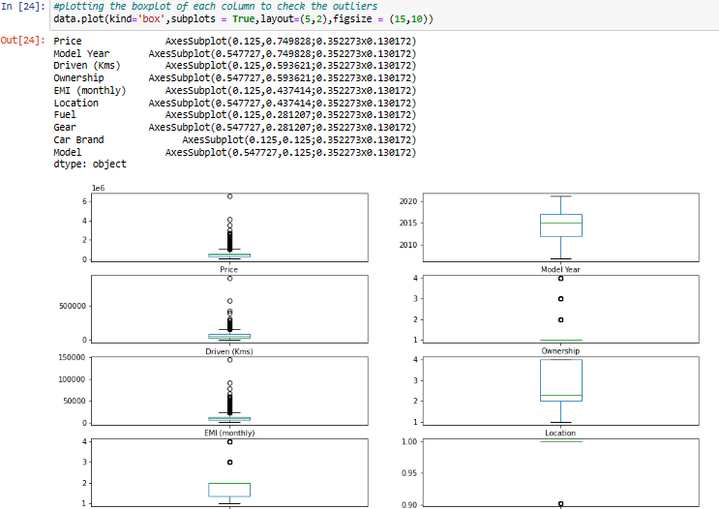
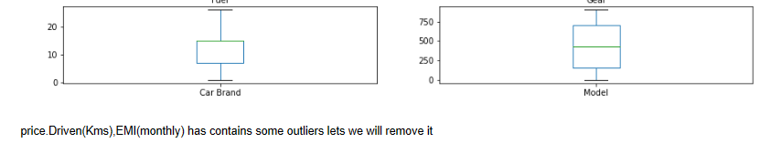
Checking of Outliers

Slide 10
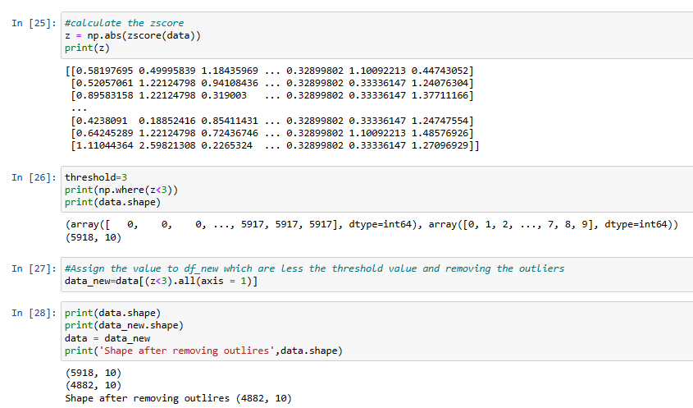
Removing outliers

Slide 11
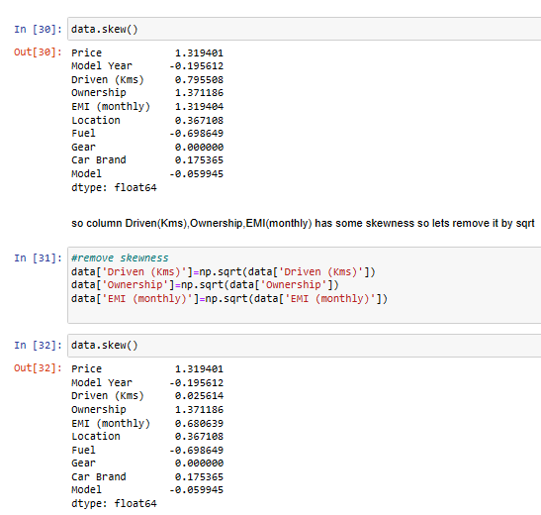
Finding the skewness in dataset

Slide 12
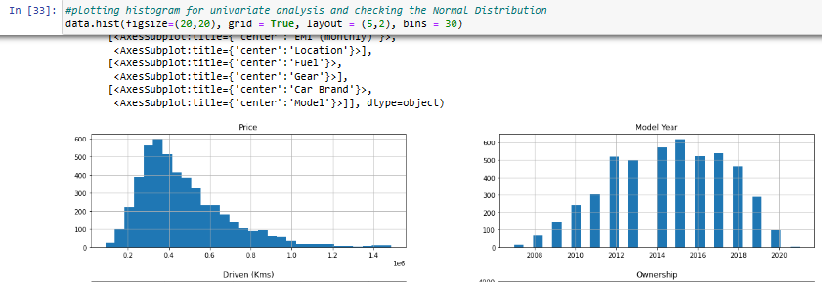
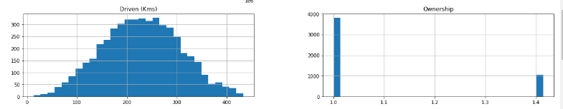
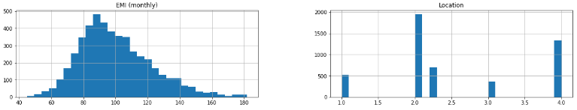
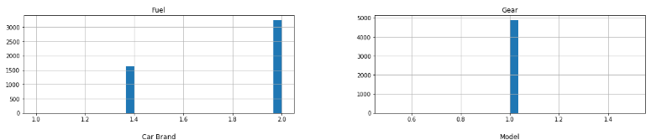
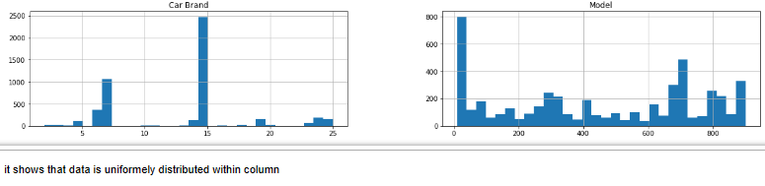
Graphical Representation of Data

Slide 13
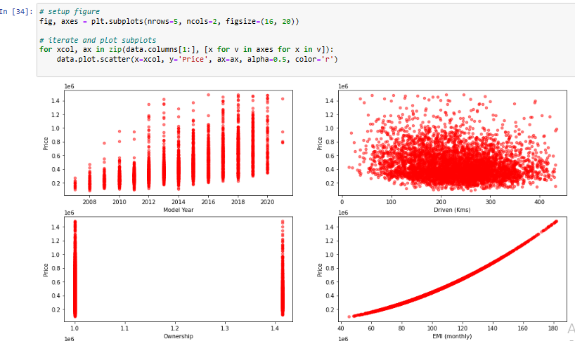
Scatter Plot

Slide 14
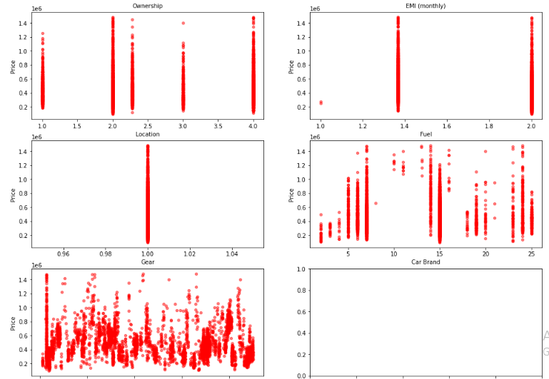

Slide 15
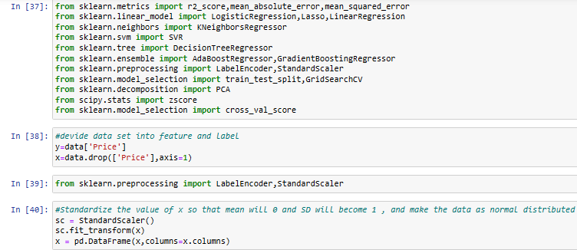
Divide dataset into x and y variable

Slide 16
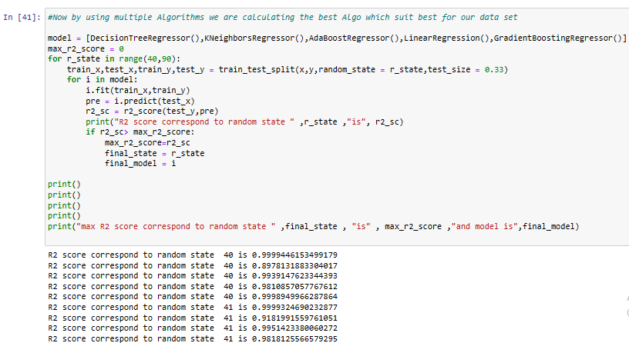

using multiple Algorithms we are calculating the best Algo which suit best for our data set

Slide 17
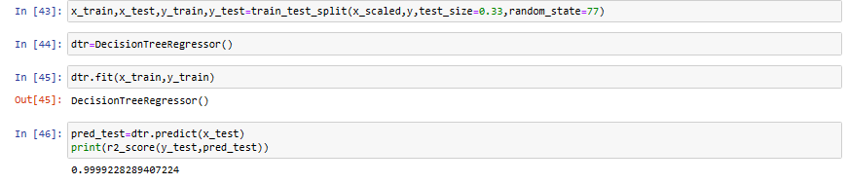
R2 score

Slide 18
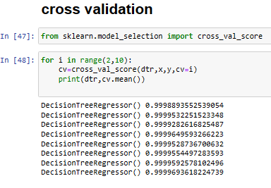
Cross Validation

Slide 19
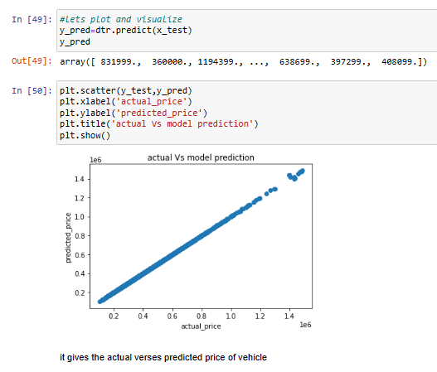
Visualization

Slide 20
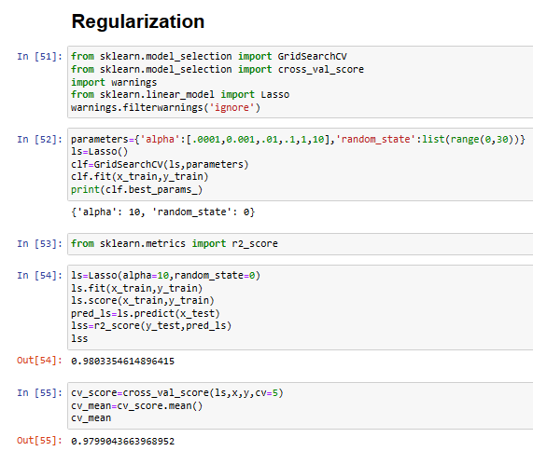
Regularization

Slide 21
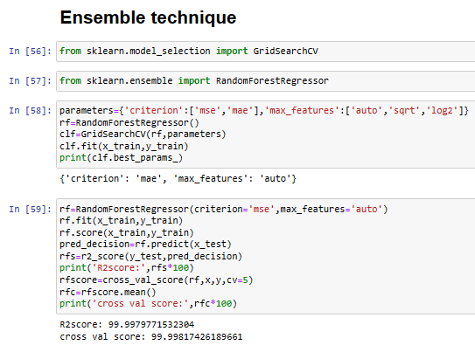
Ensemble technique

Slide 22
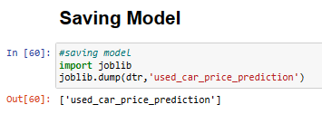
Saving Model

Slide 23
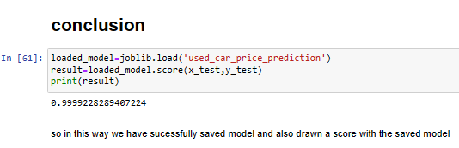
Conclusion

